Slide 1
Microsoft Teams – Use the teamwork Microsoft Graph endpoint

Slide 2
Why integrate with Microsoft Teams?
Microsoft Graph's teamwork endpoint
Protected APIs in Microsoft Teams

Slide 3
Why integrate with Microsoft Teams?
Automate team lifecycles
Get work done even when no one is around
Create teams linked to your app
Deploy apps to teams
Use Microsoft Graph in any kind of app
Get notified about changes

Slide 4
Microsoft Graph, gateway to Microsoft 365
Single resource that proxies multiple Microsoft services
Simplifies token acquisition and management
Eliminates the need to traditional discovery (using “me” and “myorganization”)
Allows for easy traversal of objects and relationships

Slide 5
Accessing the Microsoft Graph
Direct REST API
Any platform
Any language
Any framework
Native SDKs
Utilize framework & platform specific implementations
Abstracts the details of constructing & processing REST requests over HTTP
.NET, iOS, Android, PhP, Ruby, JavaScript, etc.

Slide 6
Microsoft Graph's teamwork endpoint

Slide 7
Microsoft Graph & the teamwork endpoint
Remember: Microsoft Teams teams are founded on Microsoft 365 groups & SharePoint sites
Many API calls will use the /groups endpoint
Microsoft Graph’s teamwork endpoint: /team
Require consent among many different scopes
TeamsApp.*
TeamSettings.*
TeamsTab.*
Team.Create
Team.ReadBasic.All
TeamMember.*
TeamsActivity.*

Slide 8
Create teams: (1) create Microsoft 365 group
POST https://graph.microsoft.com/v1.0/groups
{
"displayName":"Flight 157", "mailNickname":"flight157",
"description":"Everything about flight 157",
"visibility":"Private",
"groupTypes":["Unified"],
"mailEnabled":true, "securityEnabled":false,
"members@odata.bind":[
"https://graph.microsoft.com/v1.0/users/bec05f3d-a818-4b58-8c2e-2b4e74b0246d",
"https://graph.microsoft.com/v1.0/users/ae67a4f4-2308-4522-9021-9f402ff0fba8"
],
"owners@odata.bind":[
"https://graph.microsoft.com/v1.0/users/6a1272b5-f6fc-45c4-95fe-fe7c5a676133"
]
}

Slide 9
Create teams: (2) convert a group
POST https://graph.microsoft.com/v1.0/teams
Content-Type: application/json
{
"template@odata.bind": "https://graph.microsoft.com/v1.0/teamsTemplates('standard')",
"group@odata.bind": "https://graph.microsoft.com/v1.0/groups('groupId')"
}

Slide 10
List teams
List all teams:
https://graph.microsoft.com/v1.0/groups?$select=id,resourceProvisioningOptions
Get a specific team
https://graph.microsoft.com/v1.0/teams/{group-id}
List all teams the current user has joined
https://graph.microsoft.com/v1.0/me/joinedTeams

Slide 11
Protected APIs in Microsoft Teams
Some Microsoft Teams APIs exposed by Microsoft Graph access sensitive data
These APIs are considered protected APIs
Require additional validation beyond the just permissions defined & consented to in Azure AD
App developers must submit request to use protected APIs
Learn more: https://docs.microsoft.com/graph/teams-protected-apis

Slide 12
DEMO
Teamwork endpoint introduction

Slide 13
Create custom tabs in Microsoft Teams channels
Website tabs
Word, Excel, PowerPoint, and PDF tabs
SharePoint document library, list, and page tabs
Additional tabs

Slide 14
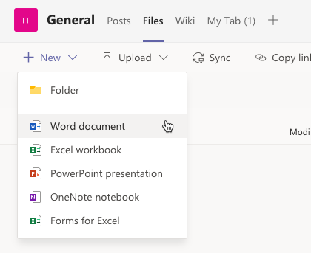
Microsoft Teams’ built-in channel tabs
Microsoft Teams includes multiple built-in channel tabs
Use these tabs to display rich content to your channel members
Many tabs are configurable to specify the content they should display
Some support including website URLs to jump out of Microsoft Teams and into a browser

Slide 15
Use Microsoft Graph’s teamwork endpoint to create and update tabs
Create and manage Microsoft Teams tabs with the teamwork endpoint
Must include the Microsoft Team’s ID and channel ID
https://graph.microsoft.com/v1.0/teams/{groupId}/channels/{channelId}/tabs
Must include the Microsoft Team’s ID and channel ID
Use the team’s groupID for the team’s ID
Working with the endpoint
Get tabs using HTTP GET
Create tabs using HTTP POST
Include a configuration object when creating or updating tabs

Slide 16
Microsoft Graph’s tab endpoint
HTTP POST https://graph.microsoft.com/v1.0/teams/{groupId}/channels/{channelId}/tabs
Content-Type: application/json
{
"displayName": ”My new tab",
"teamsApp@odata.bind" : "https://graph.microsoft.com/v1.0/appCatalogs/teamsApps/{teamsAppId}",
"configuration": {
"entityId": "CA2E9D19-3FE7-4E60-82DF-F73BD3B8D302",
"contentUrl": "https://{tenant}.sharepoint.com/sites/TestTeam/Shared Documents/General/sample.docx",
"removeUrl": null,
"websiteUrl": null
}
}

Slide 17
Built-in tabs & app IDs
"teamsApp@odata.bind" : "https://graph.microsoft.com/v1.0/appCatalogs/teamsApps/{teamsAppId}"
Microsoft Teams build-in apps have well-known IDs for their configurable tabs
Tab IDs are defined in the installed app’s manifest
When configuring a tab, the teamsApp@odata.bind property tells Microsoft Teams what tab to load
App IDs are either strings or GUIDs depending on the app

Slide 18
Configuring built-in tabs
"configuration": {
"entityId": "CA2E9D19-3FE7-4E60-82DF-F73BD3B8D302",
"contentUrl": "https://{tenant}.sharepoint.com/sites/TestTeam/Shared Documents/General/sample.docx",
"removeUrl": null,
"websiteUrl": null
}
Some properties are required (contentUrl) for most tabs, some are rarely required (removeUrl)
contentUrl: content to display in the tab
websiteUrl: page to direct the user to when the tab can’t be shown (certain clients)
removeUrl: page to display in a dialog when tab is deleted from the channel
entityId: sometimes used to reference a specific item (Word, Excel, PowerPoint, etc)

Slide 19
Tab App Ids
Tab App | teamsAppId
Word | com.microsoft.teamspace.tab.file.staticviewer.word
Excel | com.microsoft.teamspace.tab.file.staticviewer.excel
PowerPoint | com.microsoft.teamspace.tab.file.staticviewer.powerpoint
PDF | com.microsoft.teamspace.tab.file.staticviewer.pdf
Website | com.microsoft.teamspace.tab.web
SharePoint document library | com.microsoft.teamspace.tab.files.sharepoint
SharePoint list / page | 2a527703-1f6f-4559-a332-d8a7d288cd88
Microsoft Stream | com.microsoftstream.embed.skypeteamstab
Microsoft Forms | 81fef3a6-72aa-4648-a763-de824aeafb7d
OneNote | 0d820ecd-def2-4297-adad-78056cde7c78
Planner | com.microsoft.teamspace.tab.planner
Power BI | com.microsoft.teamspace.tab.powerbi

Slide 20
Tab configuration properties
App | entityId | contentUrl | websiteUrl | removeUrl
Word, Excel, PowerPoint, PDF | Source document ID | URL to the file in the underlying SharePoint document library | null | null
Website | URL | URL | null | null
SharePoint document library | “” | URL to the underlying SharePoint document library | null | null
SharePoint list / page | null | null | null | null
Microsoft Stream | null | null | null | null
Microsoft Forms | null | null | null | null
OneNote | null | null | null | null
Planner | null | null | null | null
Power BI | null | null | null | null

Slide 21
DEMO
Configure a built-in tab with Microsoft Graph

Slide 22
Understanding the basics of activity feed notification
Requirements for sending activity feed notifications
Sending activity feed notifications

Slide 23
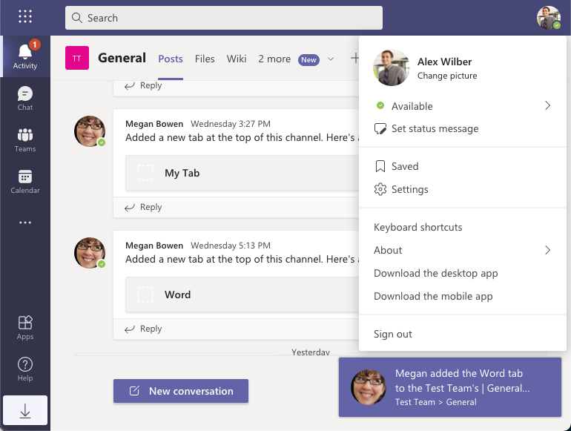
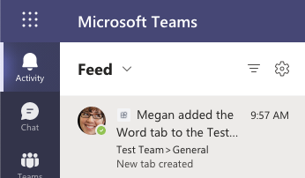
Activity feed notifications
Enables apps to notify users to see relevant items specific to them

Slide 24
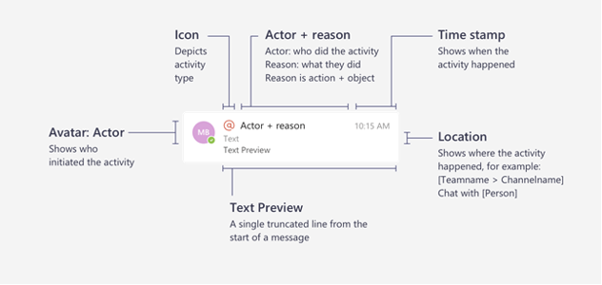
Anatomy of an activity feed notification

Slide 25
Activity feed notification capabilities
notify a user
notify a user in a team
notify a user in chat

Slide 26
Requirements for sending activity feed notifications
Custom Microsoft Teams app must be installed for the recipient of the notification
1
Custom Microsoft Teams app must be associated with an Azure AD app registration
2
Notification activity types must be registered in the custom Microsoft Teams app’s manifest
3

Slide 27
Associate Microsoft Teams apps with Azure AD apps
manifest.json
{
"$schema": "",
"manifestVersion": "1.8",
...
"webApplicationInfo": {
"id": "8a2d385d-8504-43f8-a9b2-80caa44bfe22",
"resource": "api://app.contoso.com/8a2d385d-8504-43f8-a9b2-80caa44bfe22"
}
}

Slide 28
Register the supported activity types
manifest.json
{
"manifestVersion": "1.8",
...
"activities": {
"activityTypes": [
{
"type": "userMention",
"description": "Personal Mention Activity",
"templateText": "{actor} added the {tabName}"
}
]
}
}

Slide 29
SendActivityNotification endpoint
HTTP POST https://graph.microsoft.com/v1.0/teams/{groupId}/sendActivityNotification
{
"topic": { "source": "entityUrl", "value": `https://graph.microsoft.com/v1.0/teams/{groupId}` },
"activityType": "userMention",
"previewText": { "content": "New tab created" },
"recipient": {
"@odata.type": "microsoft.graph.aadUserNotificationRecipient",
"userId": "{recipient-objectID}"
},
"templateParameters": [
{ "name": "tabName", "value": "Word" }
]
}

Slide 30
DEMO
Use Microsoft Graph to post to the activity feed

